Slide 1
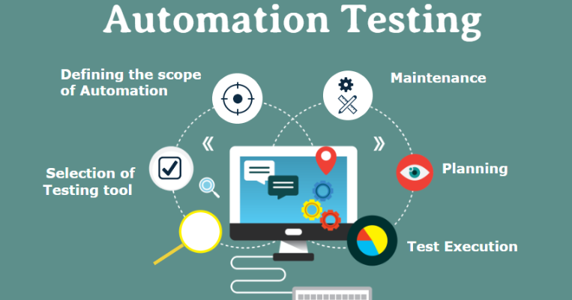
Automation Testing

Slide 2
Automation Testing – Software Testing
Automated Testing is a technique where the Tester writes scripts on their own and uses suitable Software or Automation Tool to test the software.
It is an Automation Process of a Manual Process.
It allows for executing repetitive tasks without the intervention of a Manual Tester.
It is used to automate the testing tasks that are difficult to perform manually.
Automation tests can be run at any time of the day as they use scripted sequences to examine the software.
Automation tests can also enter test data compare the expected result with the actual result and generate detailed test reports.
The goal of automation tests is to reduce the number of test cases to be executed manually but not to eliminate manual testing.
It is possible to record the test suit and replay it when required.

Slide 3
Some of the reasons for using automation testing:
Quality Assurance: Manual testing is a tedious task that can be boring and at the same time error-prone. Thus, using automation testing improves the quality of the software under test as more test coverage can be achieved.
Error or Bug-free Software: Automation testing is more efficient for detecting bugs in comparison to manual testing.
No Human Intervention: Manual testing requires huge manpower in comparison to automation testing which requires no human intervention and the test cases can be executed unattended.
Increased test coverage: Automation testing ensures more test coverage in comparison to manual testing where it is not possible to achieve 100% test coverage.
Testing can be done frequently: Automation testing means that the testing can be done frequently thus improving the overall quality of the software under test.

Slide 4
Automation Testing Types
Unit testing: Unit testing is a phase in software testing to test the smallest piece of code known as a unit that can be logically isolated from the code. It is carried out during the development of the application.
Integration testing: Integration testing is a phase in software testing in which individual software components are combined and tested as a group. It is carried out to check the compatibility of the component with the specified functional requirements.
Smoke testing: Smoke testing is a type of software testing that determines whether the built software is stable or not. It is the preliminary check of the software before its release in the market.
Performance testing: Performance testing is a type of software testing that is carried out to determine how the system performs in terms of stability and responsiveness under a particular load.
Regression testing: Regression testing is a type of software testing that confirms that previously developed software still works fine after the change and that the change has not adversely affected existing features.
Security testing: Security testing is a type of software testing that uncovers the risks, and vulnerabilities in the security mechanism of the software application. It helps an organization to identify the loopholes in the security mechanism and take corrective measures to rectify the security gaps.
Acceptance testing: Acceptance testing is the last phase of software testing that is performed after the system testing. It helps to determine to what degree the application meets end users’ approval.
API testing: API testing is a type of software testing that validates the Application Programming Interface(API) and checks the functionality, security, and reliability of the programming interface.
UI Testing: UI testing is a type of software testing that helps testers ensure that all the fields, buttons, and other items on the screen function as desired.

Slide 5
Automation Testing Process
Test Tool Selection: There will be some criteria for the Selection of the tool. The majority of the criteria include: Do we have skilled resources to allocate for automation tasks, Budget constraints, and Do the tool satisfies our needs?
Define Scope of Automation: This includes a few basic points such as the Framework should support Automation Scripts, Less Maintenance must be there, High Return on Investment, Not many complex Test Cases
Planning, Design, and Development: For this, we need to Install particular frameworks or libraries, and start designing and developing the test cases ussing required Software Automation Tools
Test Execution: Final Execution of test cases will take place in this phase and it depends on Language to Language for .NET, we’ll be using NUnit, for Java, we’ll be using JUnit, for JavaScript, we’ll be using QUnit or Jasmine, etc.
Maintenance: Creation of Reports generated after Tests and that should be documented to refer to that in the future for the next iterations.

Slide 6
Advantages of Automation Testing
Simplifies Test Case Execution: Automation testing can be left virtually unattended and thus it allows monitoring of the results at the end of the process. Thus, simplifying the overall test execution and increasing the efficiency of the application.
Improves Reliability of Tests: Automation testing ensures that there is equal focus on all the areas of the testing, thus ensuring the best quality end product.
Increases amount of test coverage: Using automation testing, more test cases can be created and executed for the application under test. Thus, resulting in higher test coverage and the detection of more bugs. This allows for the testing of more complex applications and more features can be tested.
Minimizing Human Interaction: In automation testing, everything is automated from test case creation to execution thus there are no changes for human error due to neglect. This reduces the necessity for fixing glitches in the post-release phase.
Saves Time and Money: The initial investment for automation testing is on the higher side but it is cost-efficient and time-efficient in the long run. This is due to the reduction in the amount of time required for test case creation and execution which contributes to the high quality of work.
Earlier detection of defects: Automation testing documents the defects, thus making it easier for the development team to fix the defect and give a faster output. The earlier the defect is identified, the more easier and cost-efficient it is to fix the defects.

Slide 7
Disadvantages of Automation Testing
High initial cost: Automation testing in the initial phases requires a lot of time and money investment. It requires a lot of effort for selecting the tool and designing customized software.
100% test automation is not possible: Generally, the effort is to automate all the test cases but in practical real situations not all test cases can be automated some test cases require human intervention for careful observation. There is always a human factor, i.e., it can’t test everything like humans(design, usability, etc.).
Not possible to automate all testing types: It is not possible to automate tests that verify the user-friendliness of the system. Similarly, if we talk about the graphics or sound files, even their testing cannot be automated as automated tests typically use textual descriptions to verify the output.
Programming knowledge is required: Every automation testing tool uses any one of the programming languages to write test scripts. Thus, it is mandatory to have programming knowledge for automation testing.
False positives and negatives: Automation tests may sometimes fail and reflect that there is some issue in the system but there is no issue present and in some cases, it may generate false negatives if tests are designed to verify that some functionality exists and not to verify that it works as expected.

Slide 8
Why automated testing?
Automating your testing allows you to test faster and more efficiently. Test automation is an indispensable part of software development work, because with a high rate of application use and development, manual testing is simply becoming insufficient.
Every day, applications are being developed and then used by thousands, if not millions of users. Before each launch and release to the market, running tests for these applications is a must to ensure an optimal experience for the end user.
Testing requires a lot of effort from the team. Even so, a tested system could still contain bugs. There are rarely enough resources and time to test the application adequately, and test failures take place frequently. This is where automation engineering with automation testing tools comes to the rescue.
As the reports show, the global market for automation testing has grown significantly as a result of the rapid adoption of advanced technologies. Test automation has already replaced 50% (or more) of the manual testing efforts, as the PractiTest report shows.

Slide 9
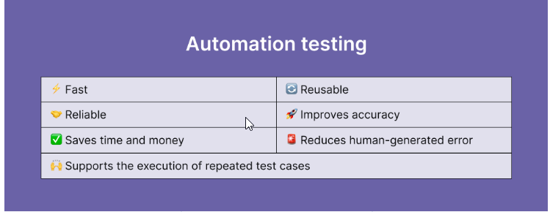

Slide 10
The following are some of the key factors of whether automated software testing should be the preferred option:
Complex and/or time consuming tasks
Impossible or difficult to run manually tests
Repetitive tasks
Tests run frequently
Basic smoke-level tests
Functional testing
Performance or load testing
Advanced GUI testing
High-risk cases
Critical components
Cross-platform testing

